Slide 1
Evaluating Cable News Bias with NLU
CDT Seth Benson
Advisor: MAJ Cruickshank

Slide 2
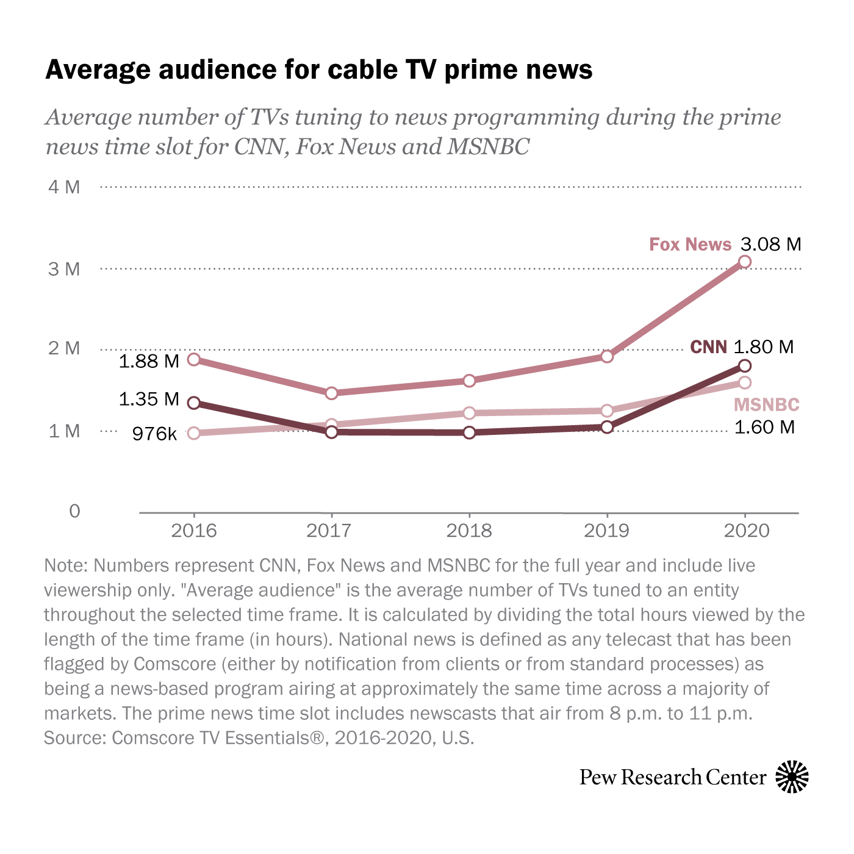
Cable News
Still draws large audiences
Wide range of topics presented
Generally biased in the opinions presented

Slide 3
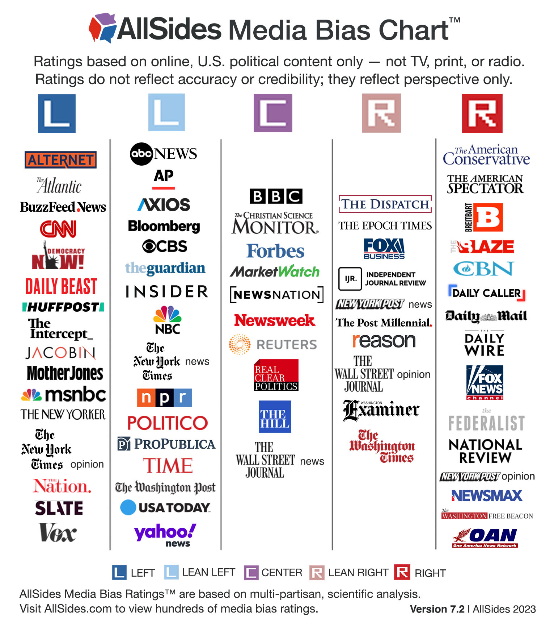
How do you determine cable news bias?
Common perception
Subjective measurements
Limited existing research

Slide 4
Goal: Dynamic Bias Description
Remove subjective assessment
Determine the topics discussed and the sentiment towards them
Compare across programs to determine bias

Slide 5
Goal: Dynamic Bias Description
Data Cleaning
Store Transcript Metadata
Break Into Individual Statements
Transcript Analysis
Named Entity Recognition
VADER Sentiment Analysis
Program Comparison
TF-IDF Topic Keyword Similarity Network (T)
Sentiment Similarity Network (S)
Program Clustering
Topic-Sentiment Similarity Network
P = T ⊙ S
Program Similarity Clustering

Slide 6
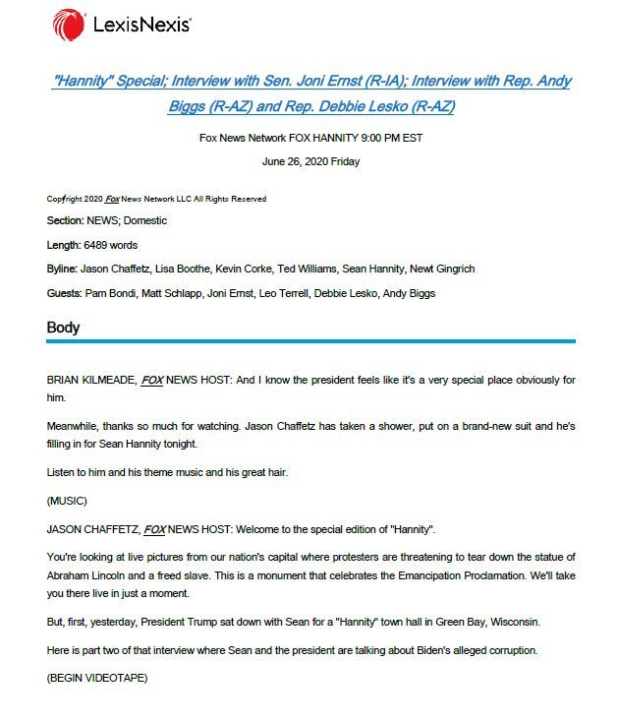
Data Cleaning
All CNN, Fox, and MSNBC news transcript in 2020
Over 14,000 total
Store program and date
Break individual statements

Slide 7
Transcript Analysis
Use spaCy Named Entity Recognition (EntityRecongnizer)
Store top fifteen named entities for each transcript used in at least three sentences
Other approaches included most used nouns or most used words within GSDMM topics
Use VADER for sentiment analysis
Store VADER composite polarity score for each key word
Average polarity score of all sentences containing that key word

Slide 8
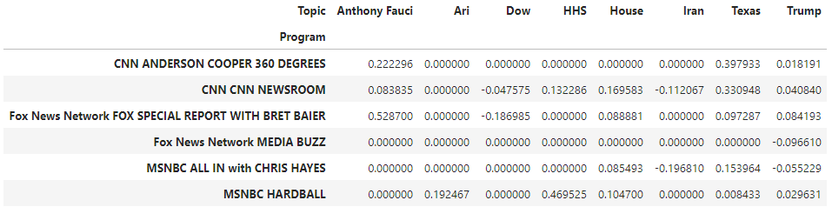
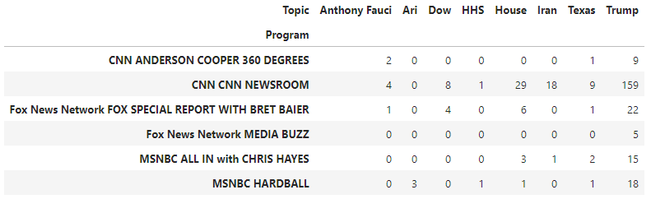

Program Comparison
TF-IDF Topic Similarity Network ($T_{p,p}$)
Create program - key word matrix with the frequency of each program – key word combination
Use TF-IDF (Term Frequency - Inverse Document Frequency) to weigh for word relevancy ($B_{p,t}$)
Use cosine similarity to create program to program topic similarity matrix ($T_{p,p}$)
Sentiment Similarity Network ($S_{p,p}$)
Program to topic sentiment matrix ($C_{p,t}$) established through average sentiment of a program towards a named entity across all transcripts
Program to program matrix created through average similarity between sentiment in shared keywords ($S_{p,p}$)

Slide 9
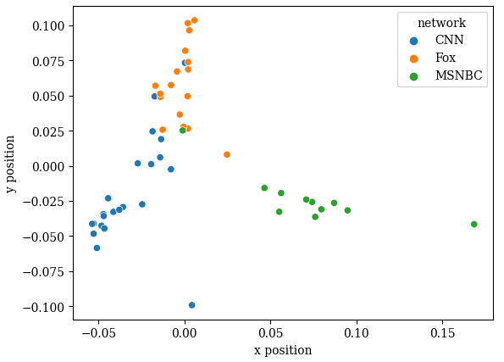

Program Clustering
Topic Sentiment Similarity Network (P)
Element-wise multiplication of topic and sentiment similarity networks
$P_{p,p}$ = $T_{p,p}$ ⊙ $S_{p,p}$
Clustering
Use Spectral Clustering to assign bias clusters to programs
Cluster monthly
Latent Space Representation
of Programs (P) in March 2020

Slide 10
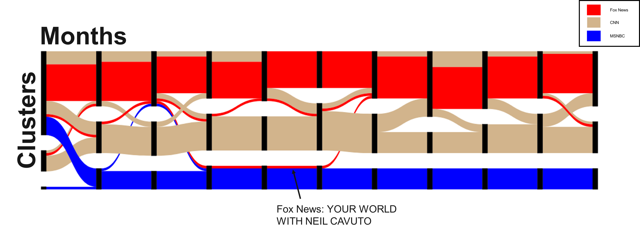
Full 2020 Results - Sankey

Slide 11
Clustering Example: March

Slide 12
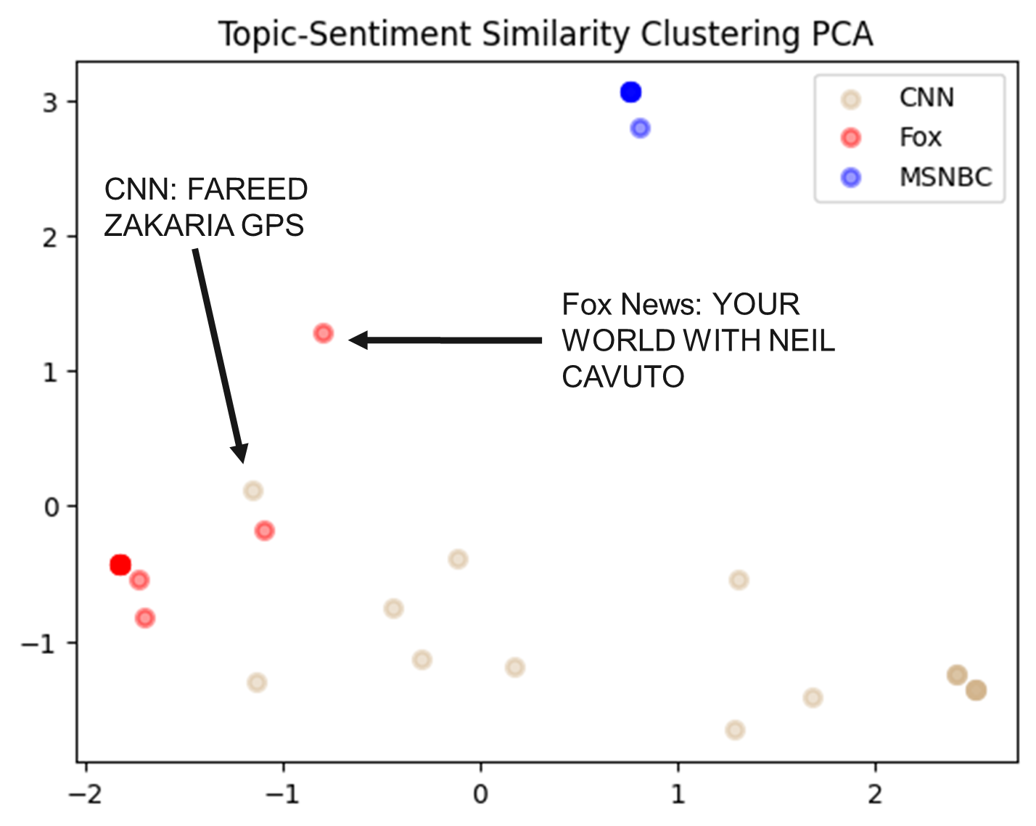
Full 2020 Results - PCA of Clusters

Slide 13
Conclusions
Clustered nature of cable news
Consistent lean of programs
Importance of key word use over sentiment in determining media landscape
Implications for military information advantage

